Slide 1

Demand forecasting in a supply chain
TEAM 1 : Sahil POPLI, Sibish Ragul BHARATHI, Xinyue ZHAO, Mohamed Mustaq Ashraf ALI, Lucile SAUVESTRE

Slide 2
TABLE OF CONTENT
Introduction​
Learning objectives​
Understanding the role of forecasting for both an enterprise and a supply chain​
Identifying the components of a demand forecast​
Analyzing demand forecast to estimate forecast errors​
Case study
Characteristics of forecast
Glossary
Summary

Slide 3

Introduction
''It’s tough to make predictions, especially about the future''
All supply chain decisions made before demand has been produced are made on a forecast.
In this presentation we will try to understand the role of demand forecasting in a supply chain, identify the components of a demand forecast and analyze to forecast error.

Slide 4
Learning objectives
1. UNDERSTANDING the role of forecasting for both an enterprise and a supply chain
2. IDENTIFYING the components of a demand forecast
3. ANALYZING demand forecasts to estimate forecast error

Slide 5

Understanding the role of forecasting
WHAT IS THE OBJECTIVE OF FORECASTING?
Forecasting is done to know how much of a product to make, how much inventory to have, how much material to order. (All parties affected by the supply chain decision should be aware of the link between decision and forecast)
A company should link its forecast to all planning activities like capacity planning, production planning, promotion planning, purchasing etc.
A common poor customer service scenario is when a retailer develops forecasts based on promotional activities and the manufacturer is unaware of this and develops a different forecast for its production planning based on previous orders.

Slide 6

Understanding the role of forecasting
Demand forecasts are the backbone of all supply chain planning
PUSH PROCESS in supply chain – performed in anticipation of customer demand
Action: Plan the level of activity like production, transportation etc.
PULL PROCESS in supply chain – performed in response to customer demand
Action: Plan the level of stock and inventory

Slide 7

Understanding the role of forecasting
COLLABORATIVE FORECASTING – THE IDEAL FORECASTING?
A collaborative forecasting is done collectively with the marketing & sales, production, transportation and the other concerned teams in the supply chain process
Forecasting in different industries :
Mature products or products with stable demand are easy to forecast (milk, paper towels)
Fashion goods and high-tech products are always difficult to forecast

Slide 8
Identifying the components of a demand forecast
Observed demand （O）= systematic component （S） + random component （R）
LEVEL
TREND
SEASONALITY
Cannot forecast the direction of the random component

Slide 9
Identifying THE COMPONENTS OF a DEMAND FORECAST
Level- level of demand: measure the current demand after deducting seasonal factors.
Trend- demand trend: measure the current rate of growth or decline in demand.
Seasonality- seasonal demand: measure predictable seasonal demand changes.
The idealized forecast: forecast error = random component

Slide 10

Analyzing demand forecast to estimate forecast errors

Slide 11

Definition of the forecast error
Forecast error measures the random component of demand. This measure is important because it reveals how inaccurate a forecast is likely to be and what contingencies a firm may have to plan for.

Slide 12
how forecast errors can be turned to an advantage for the company?
Determine what is the systemic component of the demand
01
Put in place contingency plans in anticipation of significant variances in demand
02
Thanks to historical data, analyze the forecasting method
03

Slide 13
MEAN SQUARE ERROR (MSE)
Is the arithmetic average of the squares of the differences between model predictions and observations.
This method is mainly used when the cost of a forecast error can generate large expenses for the company.

Slide 14
MEAN ABSOLUTE DEVIATION (MAD)
Estimates the standard deviation of the random component assuming the random component is normally distributed.
MAD is an appropriate choice when selecting forecasting methods if the cost of a forecast error is proportional to the size of the error.

Slide 15
MEAN ABSOLUTE PERCENTAGE (MAPE)
Average absolute error as a percentage of demand.
MAPE is a good measure of forecast error when the underlying forecast has significant seasonality and demand varies considerably from one period to the next.
Unfortunately, MAPE can only be applied to strictly POSITIVE values. It therefore makes it possible to judge whether the sales forecasting system is good, but it is ineffective for assessing the quality of estimates of results that can be either profits or losses.

Slide 16
THE BIAS AND THE TRACKING SIGNAL
The bias and TS are used to estimate if the forecast consistently over or under forecasts or if demand has deviated significantly from historical norms.
The bias : sum of the forecast errors
The tracking signal (TS) is the ratio of the bias and the MAD
This method is useful to detect important changes like a sudden drop or an exponential growth

Slide 17
Smoothing constant
This constant determines how historical time series values are weighted. The higher the smoothing constant, the higher the weight given to the values of the last period and therefore the faster a reaction to systematic changes in the time series is possible
Alpha- smoothing the fluctuations of the base
Beta- smoothing the fluctuations of the trend
Gamma- smoothing the fluctuations of seasonality.

Slide 18
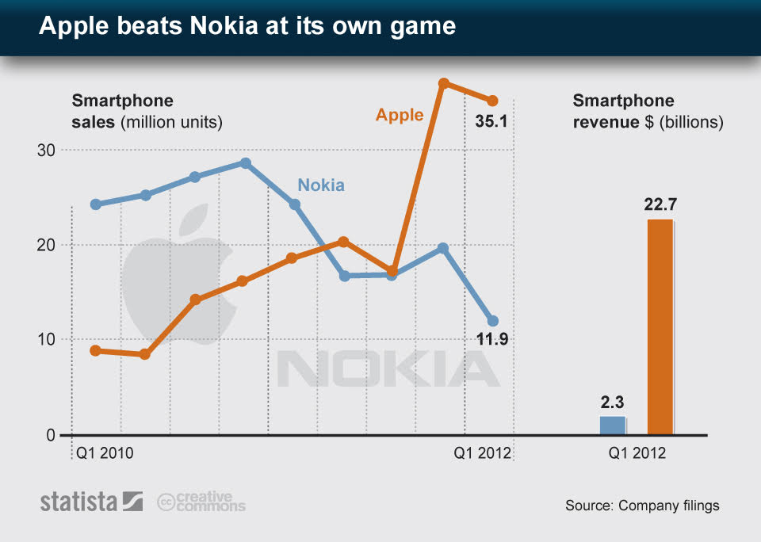

CASE STUDY

Slide 19
Characteristics of forecasts
1. Forecasts are always inaccurate, thus, forecast error occurs
2. Long-term forecasts are less accurate than short-term forecasts
3. Aggregate (combined) forecasts are more accurate than disaggregate forecasts

Slide 20
Glossary
1. Mature product – A product that has stopped growing
2. Historical time - era
3. Difficulties to (estimate) forecast examples – clothing and electronics sectors etc..,

Slide 21

summary
1. Objective of forecasting
2. Integrating demand planning and forecasting throughout the supply chain
3. Major factors that influence the demand forecast
4. Establish performance and error measures for the forecast

Slide 22
THANK YOU
TEAM 1 : Sahil POPLI, Sibish Ragul BHARATHI, Xinyue ZHAO, Mohamed Mustaq Ashraf ALI, Lucile SAUVESTRE

